Slide 1

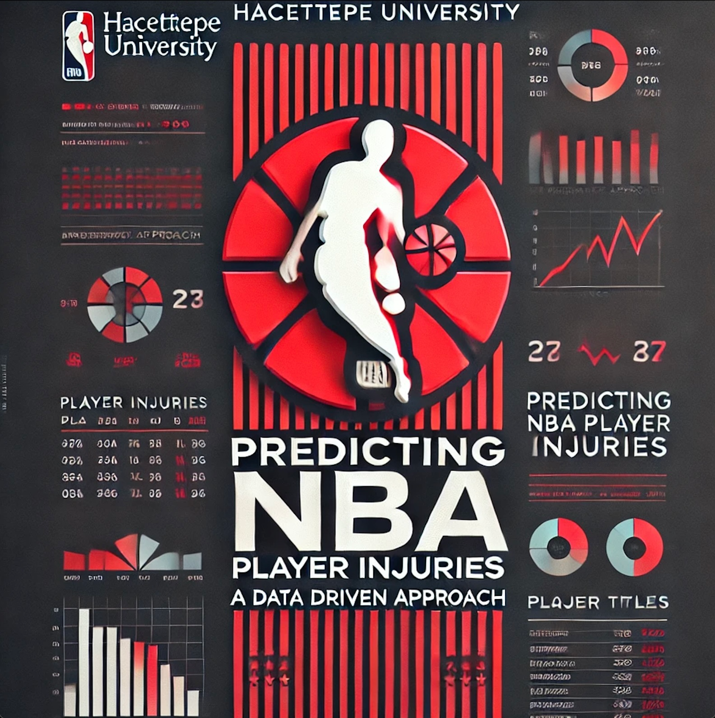
Predicting NBA Player Injuries: A Data Driven Approach
This presentation explores the development of a machine learning model to predict NBA player injuries, leveraging historical injury data and player performance metrics.
Emirhan Utku Süleyman Yolcu

Slide 2
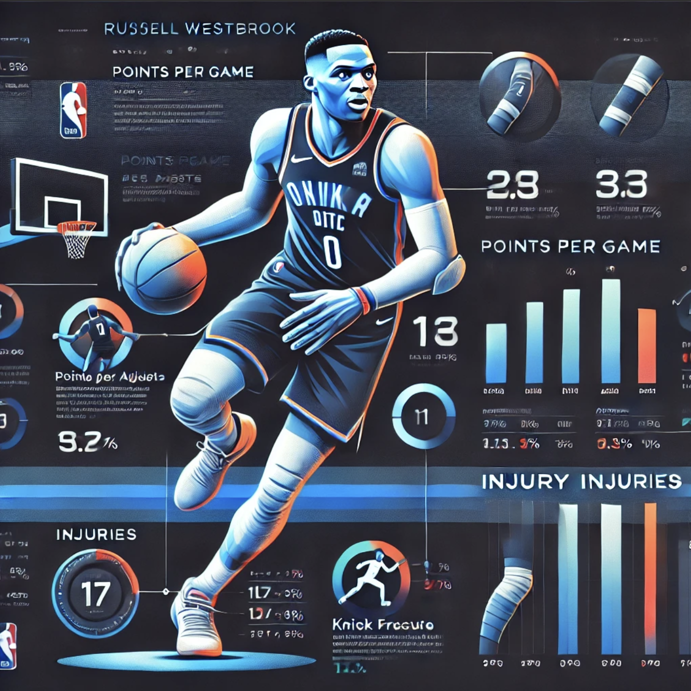
The Problem: Injuries in the NBA
Player Impact
Injuries can derail careers and shorten playing longevity.
Team Impact
Unanticipated injuries can alter season trajectories and championship aspirations.
League Impact
High-profile injuries can affect viewership, revenue, and the overall quality of competition.

Slide 3
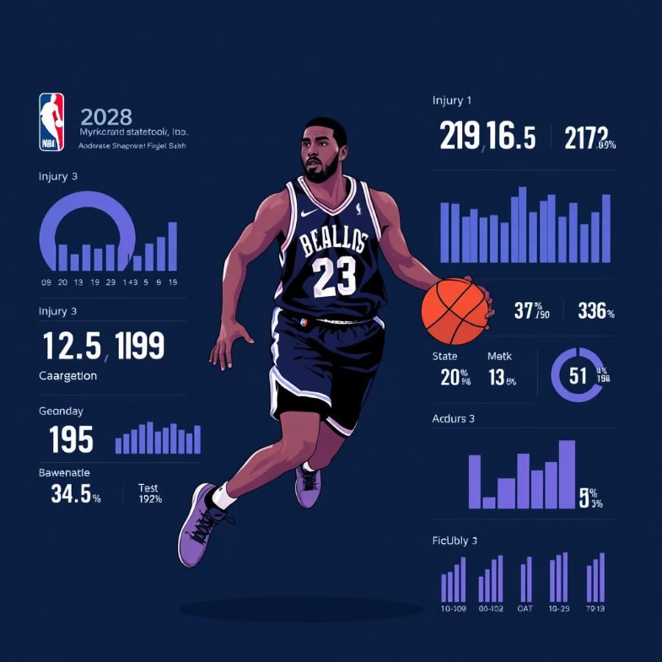
NBA player injuries can derail careers, impact team success, and reduce league revenue.
Predicting injuries helps teams make informed decisions about player management and injury prevention strategies.
Our goal: Develop a machine learning model that uses historical data to identify injury-prone players, improving player well-being and team performance.

Slide 4


Could Data Have Changed This?
Our project uses machine learning and statistical analysis to predict injury risks based on workload, performance metrics, and historical data. If such a system had existed during Rose's peak, it might have flagged elevated injury risks, allowing coaches to adjust his workload, monitor recovery, and potentially prevent his devastating injury.
Would he have won multiple MVPs? Led the Bulls to championships? These are questions we’ll never have definitive answers to.
But one thing is clear: a proactive, data-driven injury prevention system could have rewritten history for Derrick Rose and basketball fans worldwide.
Our project aims to make sure future players never have to ask, “What if?”

Slide 5

Derrick Rose’s story remains one of the most heartbreaking “what-ifs” in NBA history. In 2011, at just 22, he became the youngest MVP ever, averaging 25 points, 7.7 assists, and 4.1 rebounds per game while leading the Bulls to an NBA-best 62-20 record. His electrifying speed, creativity, and fearless drives made him seem destined for greatness.
But fate had other plans. In the 2012 playoffs, Rose tore his ACL in the final minutes of a game the Bulls were already winning. This injury marked the start of a series of health setbacks. Over the next four seasons, he played just 100 of 312 games, and his explosiveness and confidence were never fully restored.

Slide 6
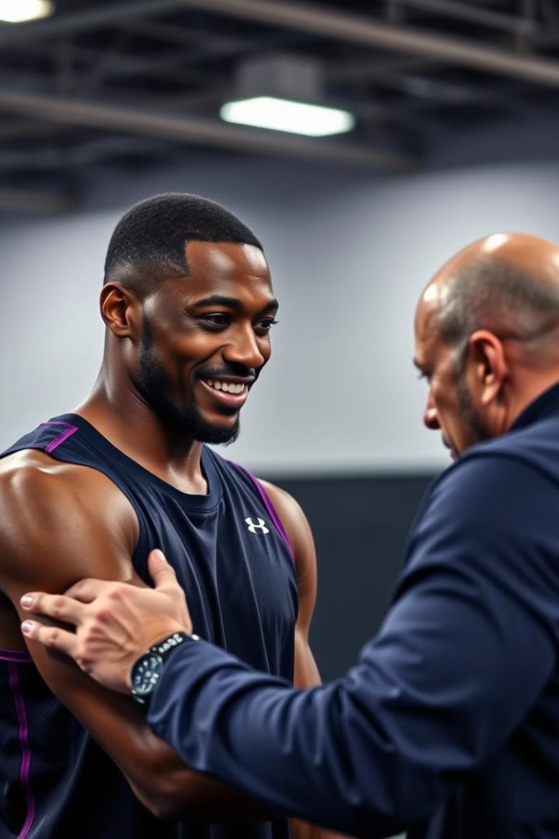
Our Approach: Machine Learning
1
Data Integration
2
Exploratory Data Analysis
Combining historical injury records with player performance metrics.
Analyzed injury trends over time, identifying common types and patterns. Explored correlations between workload and injury frequency to uncover insights for prevention.
3
Pattern Identification
4
Predictive Modeling
Identifying factors that contribute to injury risk, such as in-game statistics, minutes played, and player physical attributes.
We are developing a model to predict which players will or will not get injured based on their statistics and injury history over 10 seasons.

Slide 7
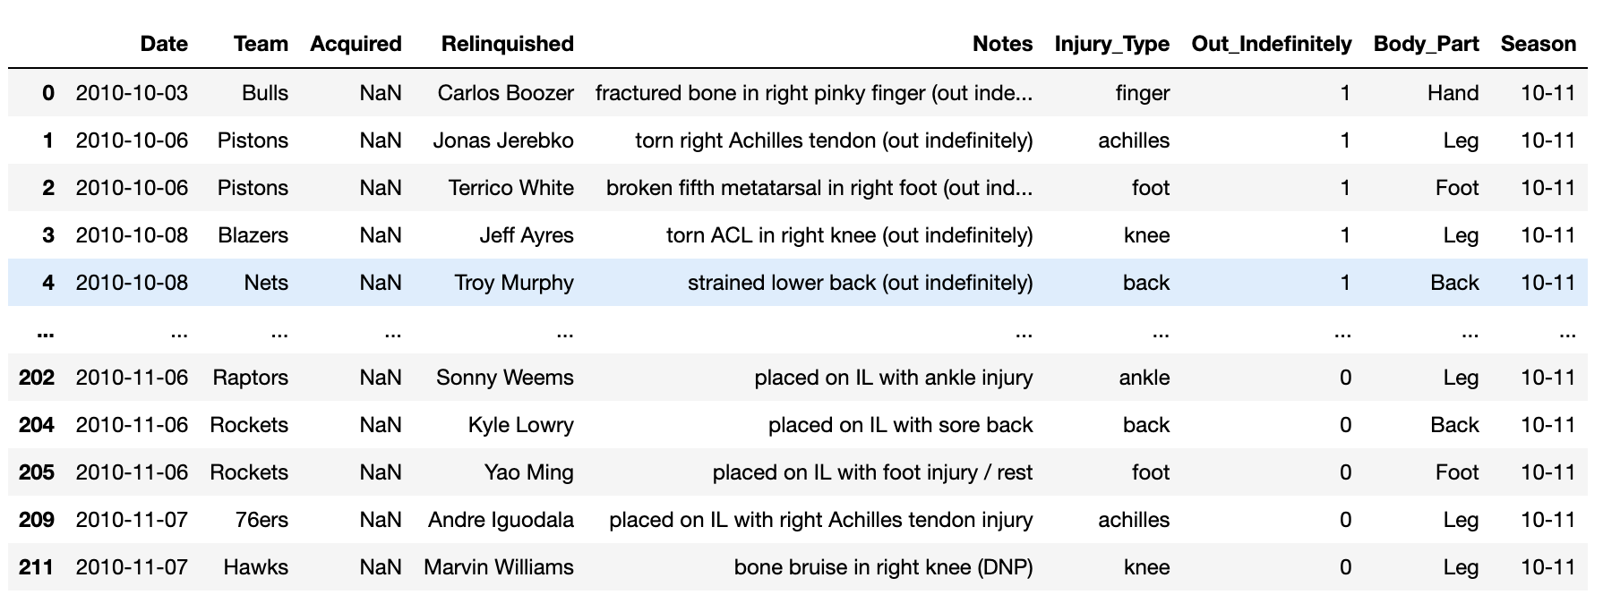
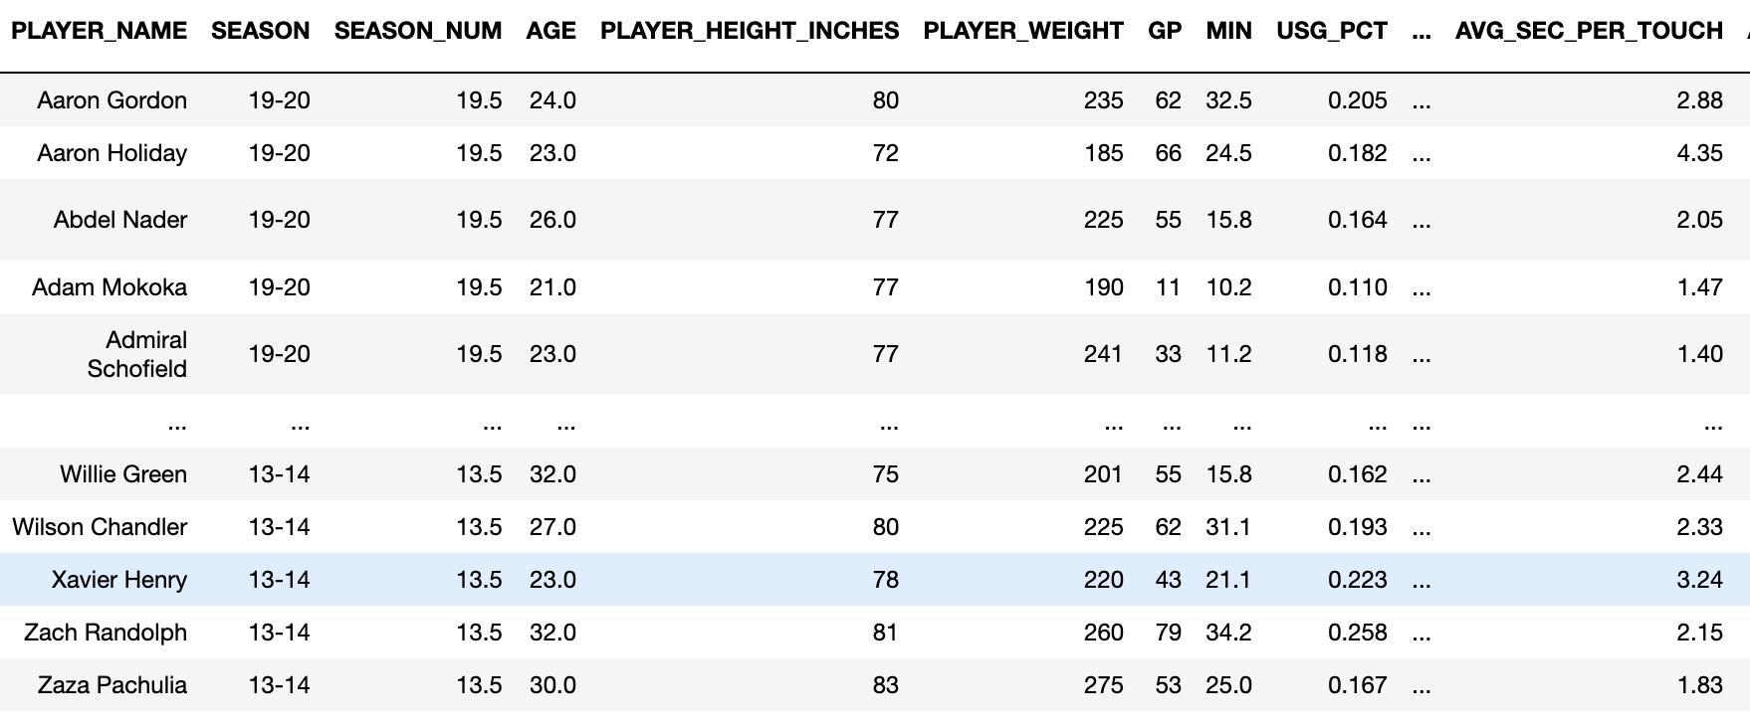
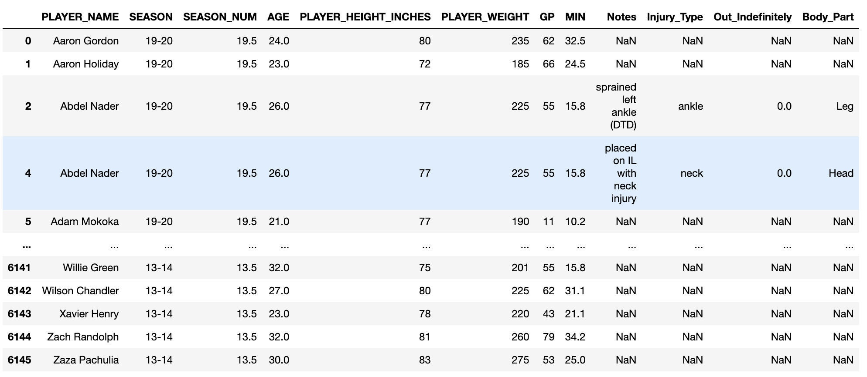
Data Integration
Player Injury Dataset
Player Performance Data
Integrated Dataset
Contains recors of NBA Player injuries, including date, team, injury type, affected body part, and whether the player was markes as ‘Out Indefinitly’ during specific seasons.
Displays player performance metrics such as season, age, height, weight, games played (GP), minutes per game (MIN) etc.
This dataset combined player performance data with injury data.

Slide 8

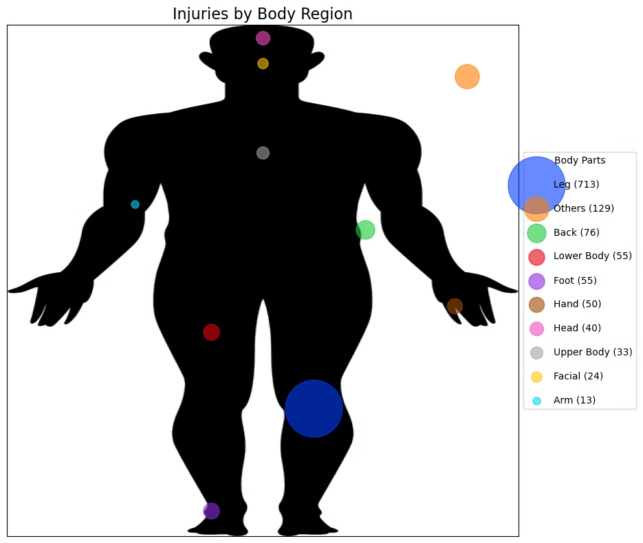




Exploratory Data Analysis (EDA)
Knee Injuries
Ankle Injuries
Most frequent injury type, often resulting in indefinite absences.
Second most frequent injury type, also contributing significantly to long-term absences.
Leg Injuries
New York Knicks
Most frequently injured body region, reflecting the high physical demands of basketball.
The team with the highest injury count.

Slide 9
Methodology: Steps from Data Preprocessing to Model Result
Data Cleaning
1
Filtered out irrelevant notes and non-injury events, ensuring only valid injury data remained.
2
Dataset Integration
Two primary datasets were used: NBA Injuries 2010–2020 and NBA Player Stats and Injured Data (2013–2023).
Feature Engineering
3
Extracted keywords from injury notes, categorized injury types, and introduced severity indicators.
4
Exploratory Data Analysis (EDA)
Visualized trends in injuries by type, team, season, and player attributes.
Model Preparation
5
Prepared data by handling missing values, encoding categories, and scaling numerical features.
6
Model Training
Trained Logistic Regression, Decision Tree, Random Forest, KNN, and SVM models.
Model Evaluation
7
Evaluated models using accuracy, precision, recall, and F1-score metrics.
8
Hyperparameter Tuning
Optimized model parameters to enhance accuracy and overall performance.
Results Comparison
9
Compared initial, cross-validation, and tuned accuracies across all models.

Slide 10
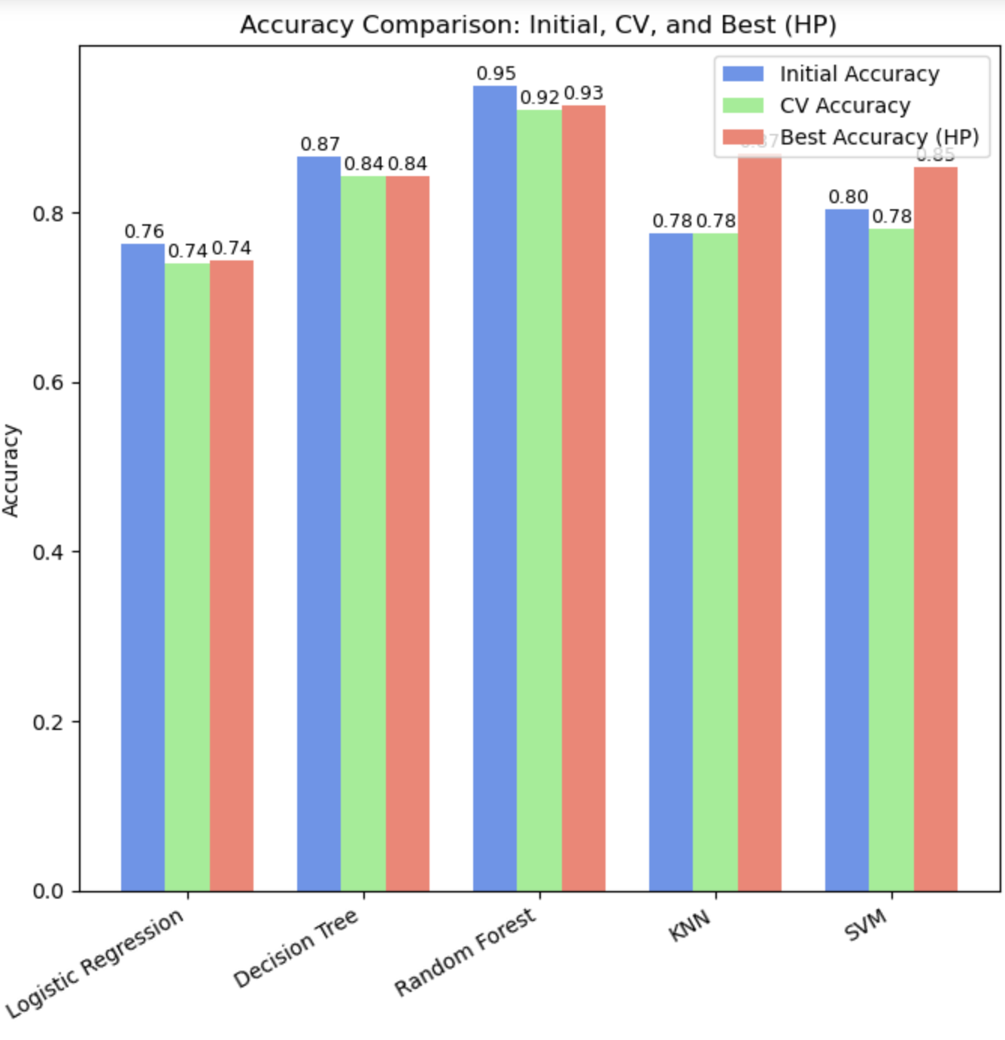
Experimental Evaluation: Model Performance
Algorithm
Initial Accuracy
Precision
Recall
F1-score
Logistic Regression
76.37%
65.25%
32.35%
43.26%
Decision Tree
86.67%
70.00%
91.18%
79.20%
Random Forest
94.97%
91.49%
90.34%
90.91%
K-Nearest Neighbors
77.54%
58.65%
65.55%
61.90%
Support Vector Machine
80.47%
74.83%
44.96%
56.17%
The results highlight the strengths of each algorithm. Random Forest excelled due to its ensemble nature, effectively handling complex patterns. SVM performed well after tuning, benefiting from clear decision boundaries in high-dimensional data. KNN improved significantly with optimized hyperparameters, while Logistic Regression and Decision Tree delivered stable but less impressive results due to their simplicity. Overall, the results emphasize the importance of algorithm selection and proper tuning for achieving high accuracy.

Slide 11
Algorithm Comparison: Strengths and Weaknesses
Random Forest
Decision Tree
Support Vector Machine
K-Nearest Neighbors
Strengths
Strengths
Strengths
Strengths
Most reliable across all metrics.
Identifies injury-prone players with interpretable results.
Reasonably well for balanced datasets and high-dimensional data.
Adequately identifies injured players with fair results.
Handles complex relationships and identifies key factors.
Useful for understanding factors contributing to injuries.
Weaknesses
Weaknesses
Weaknesses
Weaknesses
Requires more computational resources.
Less robust than ensemble methods.
Struggles to identify all injury-prone players.
Sensitive to noisy data and larger datasets.
May overfit without proper tuning.
Prone to false positives.
Requires significant effort for parameter tuning.
Leads to slower predictions and moderate performance.

Slide 12

Related Work: Existing Research
Leveraging Machine Learning to Predict NBA Player Injuries
Machine Learning for Understanding and Predicting Injuries in Football
Farghaly and P. Deshpande, "Leveraging Machine Learning to Predict National Basketball Association Player Injuries," 2024 IEEE International Workshop on Sport, Technology and Research (STAR), Lecco, Italy, 2024,
Majumdar, A., Bakirov, R., Hodges, D. et al. Machine Learning for Understanding and Predicting Injuries in Football. Sports Med - Open 8, 73 (2022).
This study used machine learning models like Random Forest, Gradient Boosting, and K-Nearest Neighbors to predict NBA injuries by analyzing physical attributes (e.g., height, weight, agility) and historical injury data. Random Forest achieved the highest accuracy (92.47%), showcasing its effectiveness in identifying injury-prone players.
This study analyzed football injuries by applying machine learning techniques to explore the relationship between training loads (e.g., external variables like velocity, acceleration, and internal variables like heart rate, fatigue) and injuries. It highlighted the potential of machine learning but noted challenges like data imbalance and limited multi-season datasets.
Similarities and Differences: Similar to our project, this study integrates physical and historical data to identify risk factors. However, our approach focuses more on in-game performance metrics, like playing time and workload, which this study does not emphasize.
Similarities and Differences: While both works use machine learning for injury prediction, our project tailors its focus to basketball-specific factors, such as high-frequency gameplay. Additionally, we address similar data preprocessing challenges but place more emphasis on model interpretability with decision trees.

Slide 13
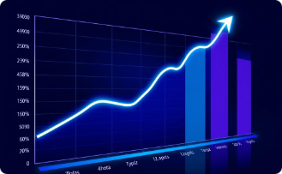

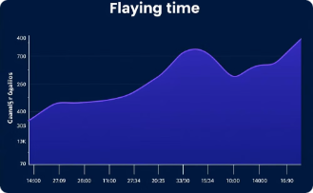
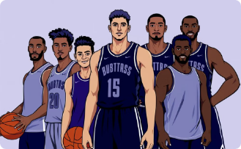
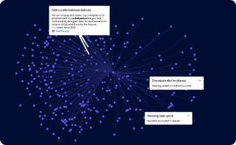
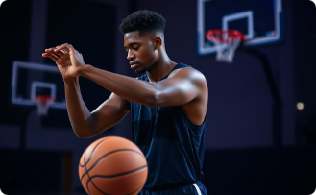

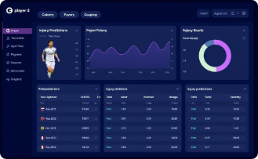
Future Direction and Open Research Questions
Explore advanced algorithms
Integrate real-time data
Utilize time-series models
Validate models across diverse datasets
Explore advanced algorithms (LightGBM, XGBoost) for improved prediction.
Integrate real-time data (player tracking, fatigue indicators) for dynamic risk assessment.
Utilize time-series models for workload analysis across games/seasons.
Validate models across diverse datasets for robustness.
Address data imbalance
External factors
Explainable AI
Real-time decision-making
How can advanced methods address data imbalance?
What external factors (recovery, travel) improve risk assessments?
Can explainable AI clarify model decisions for coaches/staff?
How can models be integrated into real-time decision-making?

Slide 14
References
Farghaly, O., & Deshpande, P. (2024). Leveraging Machine Learning to Predict National Basketball Association Player Injuries. IEEE International Workshop on Sport, Technology and Research (STAR). Link to source
Majumdar, A., Bakirov, R., Hodges, D., Scott, S., & Rees, T. (2022). Machine Learning for Understanding and Predicting Injuries in Football. Sports Medicine – Open, 8:73. Link to source
Gama Presentation Maker. Create professional presentations effortlessly with Gama App. Website Link
Kaggle Datasets: - NBA Injuries 2010-2018: Link - NBA Player Stats and Injured Data (2013–2023): Link

Slide 15
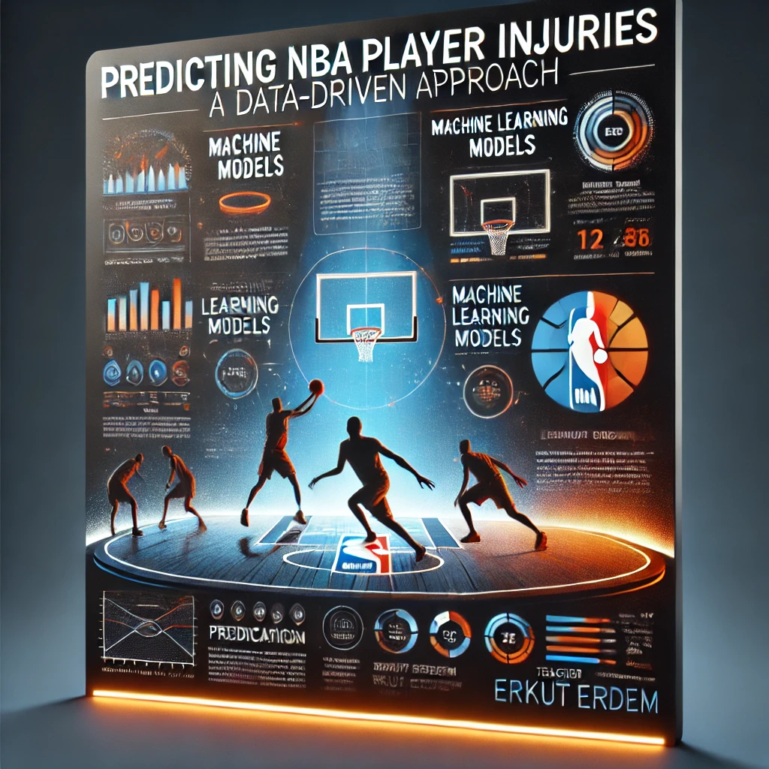

Thank You!

